Slide 1
Interview trainer agent
CAPSTONE PROJECT
Presented By:
Student name : Sathvik Palivela
College Name & Department : VSM College of Engineering, Computer Science and Engineering

Slide 2
OUTLINE
Problem Statement
Technology used
Wow factor
End users
Result
Conclusion
Git-hub Link
Future scope
IBM Certifications

Slide 3
Problem Statement
Job seekers and professionals often struggle to effectively prepare for job interviews due to the vast array of potential questions, industry-specific expectations, and evolving hiring trends. Manually researching, practicing, and refining interview responses across various roles and domains is time-consuming and inefficient, making it challenging to build confidence and achieve success in competitive job markets.
Proposed Solution: An Interview Trainer Agent uses AI to prepare users for job interviews. It generates tailored question sets and strategies based on profile, experience, and job role. Users input their resume or job title, and receive targeted questions, model answers, and improvement tips. The agent supports both technical and soft skill assessments. It aims to build user confidence and increase success rates in competitive hiring environments.

Slide 4
Technology used
IBM Cloud Lite Services:
Natural Language Processing (NLP):
NLP is a subfield of artificial intelligence that deals with the interaction between computers and humans in natural language, enabling computers to understand, interpret, and generate human language. IBM's NLP capabilities are part of its broader AI solutions, including IBM Watsonx and Granite models.
Retrieval Augmented Generation (RAG):
RAG is a technique in NLP that combines information retrieval and generative models to produce more accurate, relevant, and contextually aware responses by leveraging external knowledge bases and reducing reliance on static training data. RAG enhances the quality of generated text by retrieving relevant information from external sources and incorporating it into the generation process.
IBM Granite Model:
IBM Granite is a family of open, performant, and trusted AI models tailored for business and optimized to scale AI applications. These models provide robust natural language capabilities, including language, code, time series, and guardrail options, and are designed to work seamlessly with RAG and other AI technologies.

Slide 5
IBM cloud services used
IBM Cloud Watsonx AI Studio:
IBM Watsonx AI Studio is an integrated AI development studio that allows users to build, deploy, and manage machine learning and generative AI solutions. It provides a suite of tools for all skill levels, enabling collaboration and development of AI solutions with or without code.
IBM Cloud Watsonx AI Runtime:
IBM Watsonx AI Runtime powers the Watsonx AI Studio, providing a robust environment for building, running, and managing AI models. The runtime plan includes details for working with foundation models and metering prompt inferencing using Resource Units.
IBM Cloud Agent Lab:
IBM Cloud Agent Lab is a tool within Watsonx AI that allows users to build and deploy AI agents. These agents can be configured to make decisions and perform tasks on behalf of end-users, using specified parameters and tools. The Agent Lab is currently in beta.
IBM Granite Foundation Model:
IBM Granite is a family of open, performant, and trusted AI models tailored for business. These models deliver exceptional performance at a competitive price without compromising safety.

Slide 6
Wow factors
This agent will significantly reduce interview preparation time, improve the quality of candidate responses, help job seekers gain clarity and direction, and boost career readiness by making personalized practice more accessible and actionable.
Unique features:
Instantly generates interview questions based on job title and experience.
Offers custom tips and answer strategies to help you stand out.
Prepares you for both coding and behavioural interviews.
Helps you reduce your interview anxiety through repeated, realistic practice.

Slide 7
End users
Job Seekers:
Individuals preparing for job interviews, looking to improve their skills and confidence.
Freshers:
Recent graduates or entry-level professionals seeking to enhance their interview skills and increase their chances of getting hired.
Career Coaches:
Professionals working with clients to improve their interview skills, seeking a tool to support their coaching services.

Slide 8
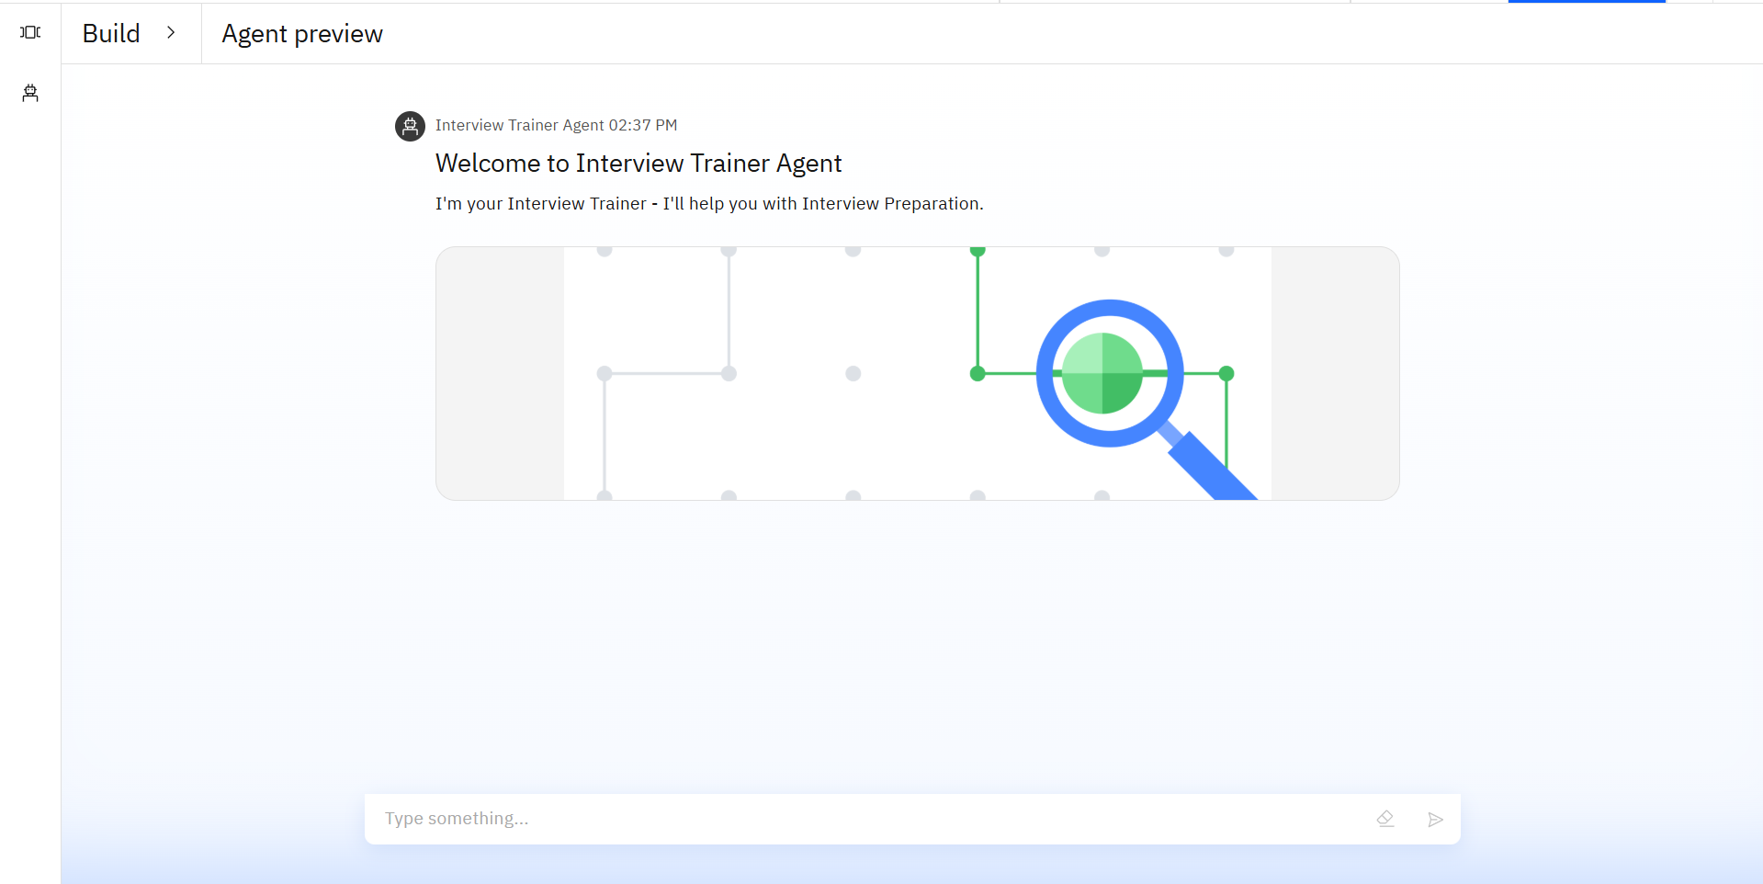
Results

Slide 9
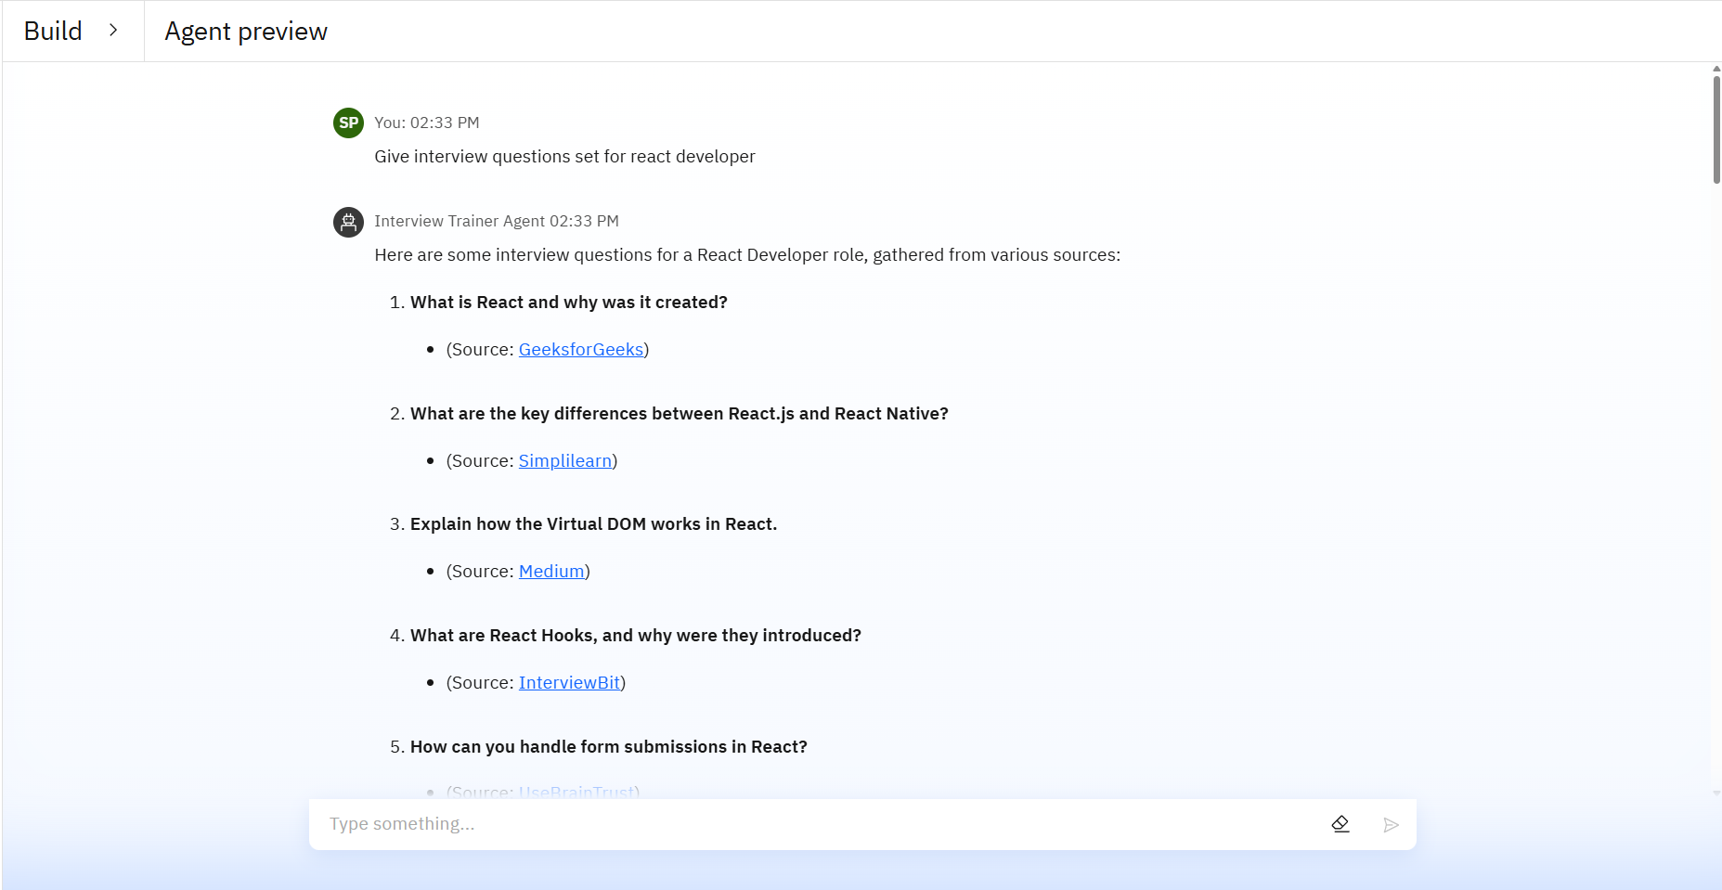
Results

Slide 10
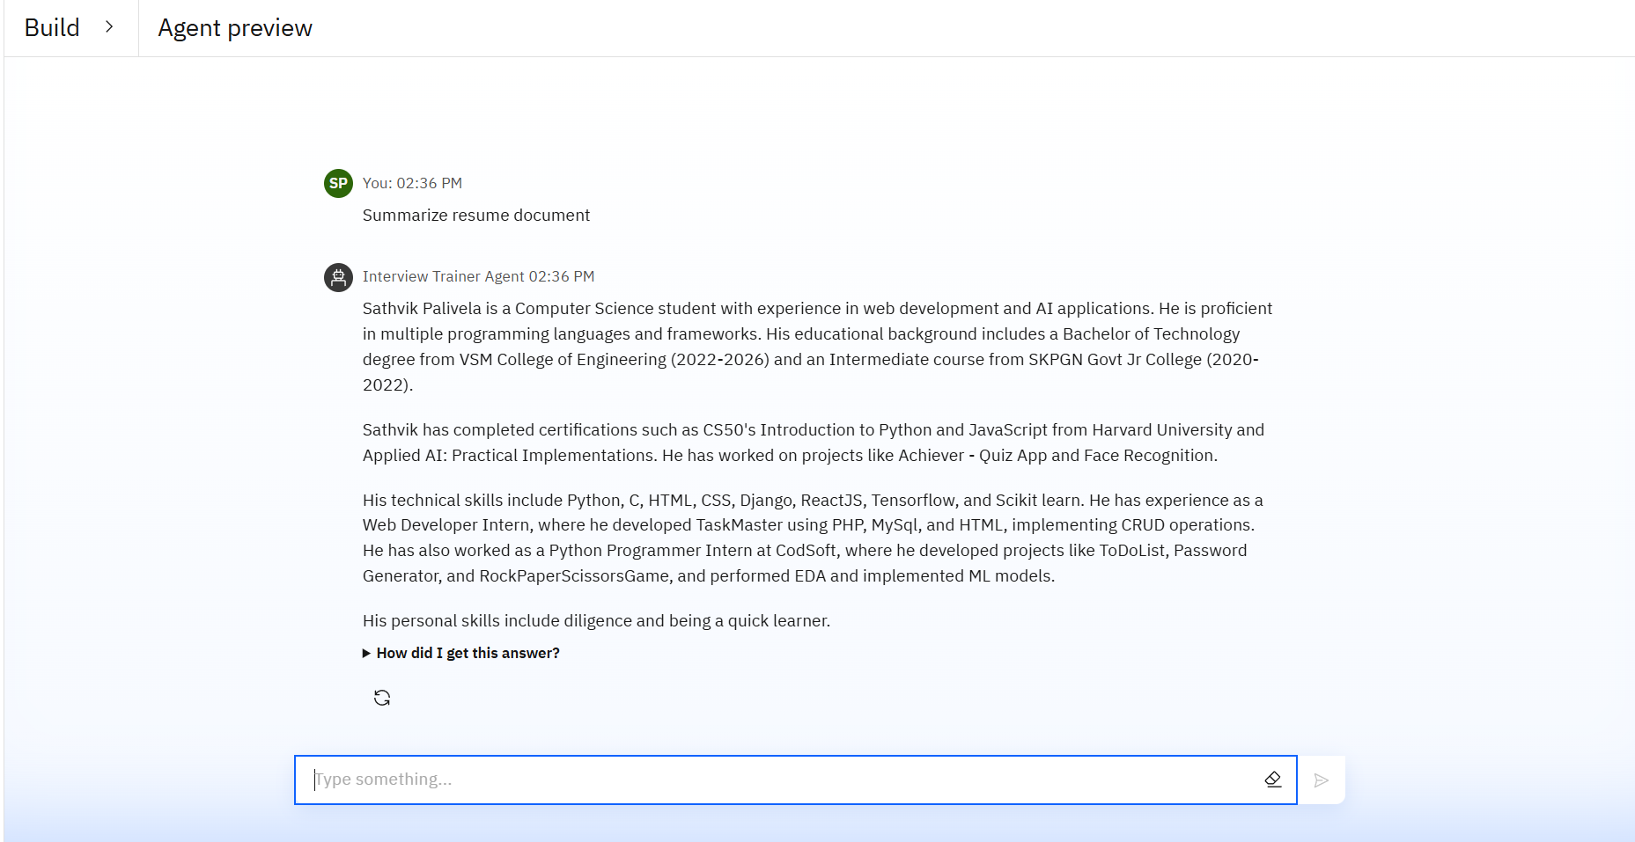
Results

Slide 11
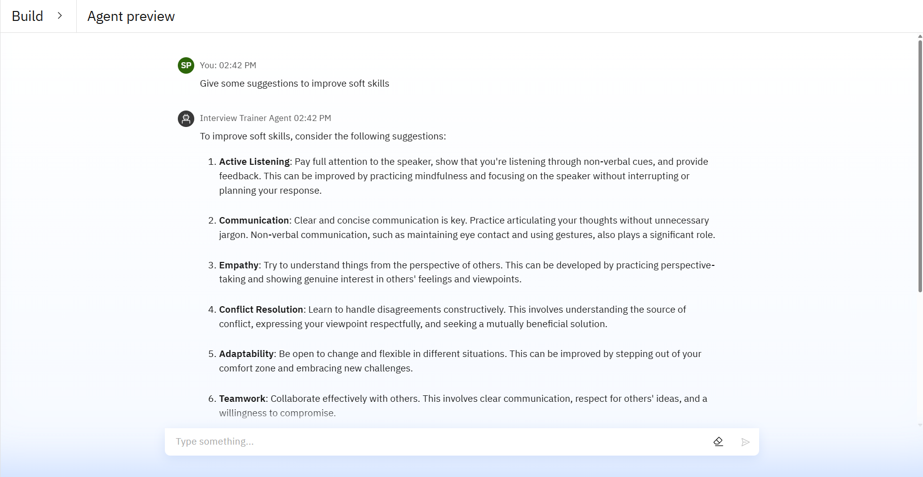
Results

Slide 12
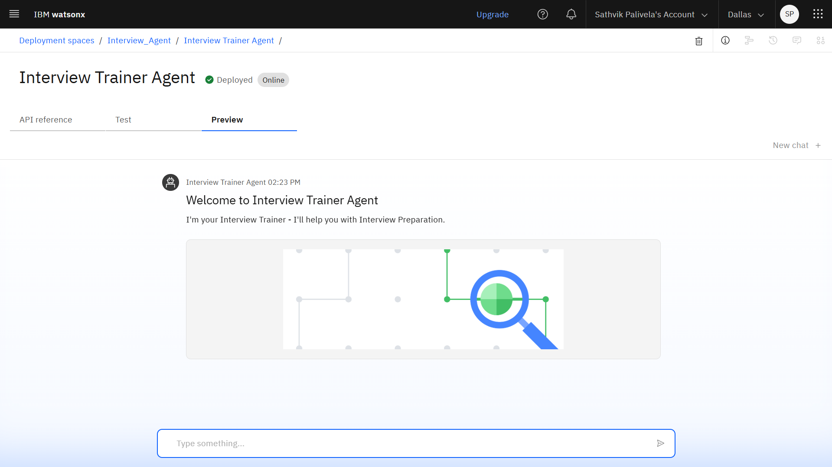
Results
Deployed AI Agent

Slide 13
Conclusion
Provides tailored question sets, model answers, and improvement tips based on user profile, experience, and job role.
Supports both technical and soft skill assessments, ensuring users are well-rounded and prepared for various aspects of the interview.
Helps users build confidence and sharpen their responses through real-world scenarios, mock interviews, and instant feedback, increasing their chances of success in competitive job markets.

Slide 14
Future scope
VR/AR-Based Interview Simulations
AI-Powered Emotion & Tone Analysis
Gamified Learning & Progress Tracking
Multilingual & Accent-Adaptive Support
Integration with Job Platforms
Integration with ATS

Slide 15
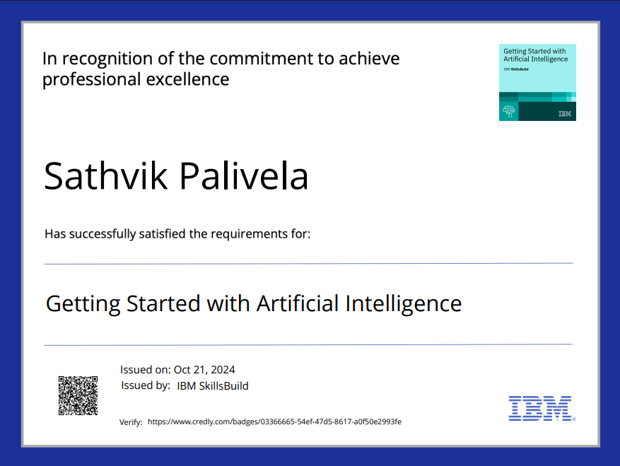
IBM Certifications
Getting Started with Artificial Intelligence

Slide 16
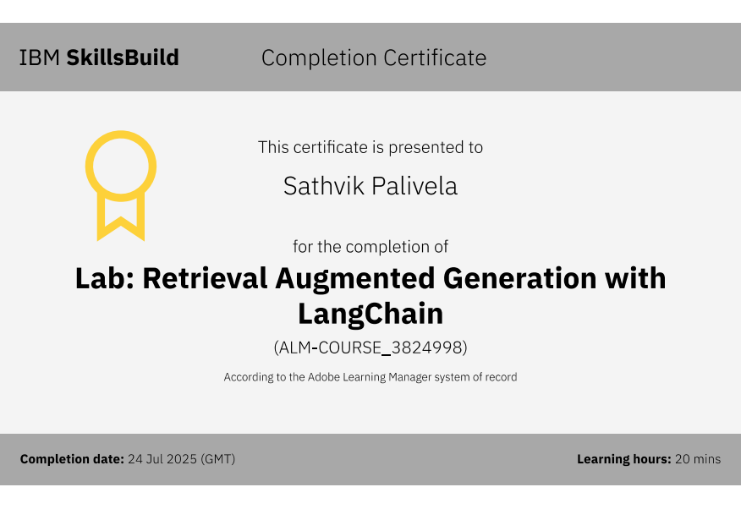
Lab: Retrieval Augmented Generation with LangChain

Slide 17
GitHub Link
GitHub Link: https://github.com/SATHVIK-CONNECT/Interview-Trainer-Agent

Slide 18
THANK YOU

